Slide 1


AccidentNow Witness Manager (ANWM)
1
Project 3
Figure 1. Application Logo

Slide 2
Project Scope
2
User able to login, logout, and create account
User able to change their profile information
User able to take photos from their camera
User able to upload photos
User able to save, change, and view past accident reports
A step-by-step guide accident flow
An artificial intelligence assistance
One-tap emergency 911 call
SHA-256 information encryption
Notes:
Talk about what part of the scope is implemented.

Slide 3
Technologies
3
Android studio
Firebase Cloud Firestone
Firebase Authentication
Gemini 3.1 Flash Lite
Kotlin

Slide 4
What is ANWM?
4
"AccidentNow Witness Manager"
A secure, immutable digital evidence repository designed for accident scene preservation.
Android Application
Empowers users on-scene to immediately capture, log, and protect critical incident data.
Firebase Backed
Provides real-time cloud data synchronization, secure user authentication, and reliable storage.
AI Assisted
AI integration to automate data entry, analyze scene context, or streamline reporting.

Slide 5
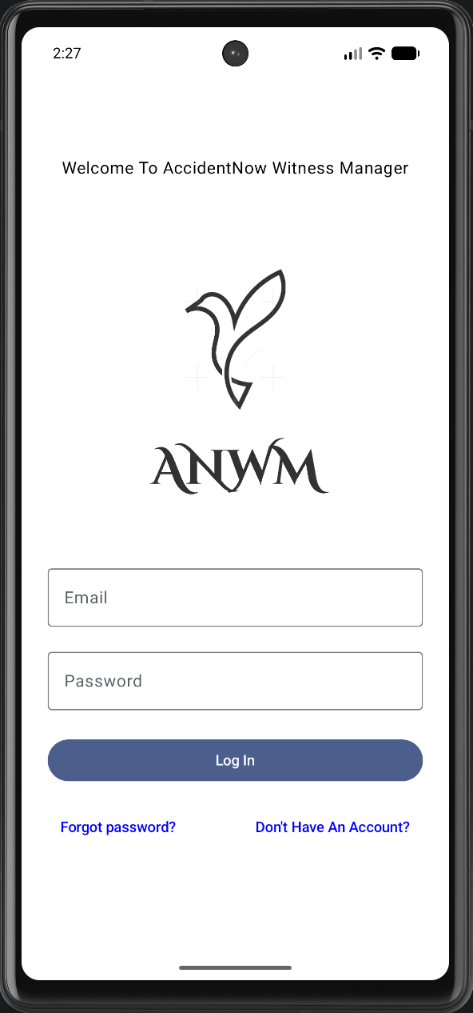
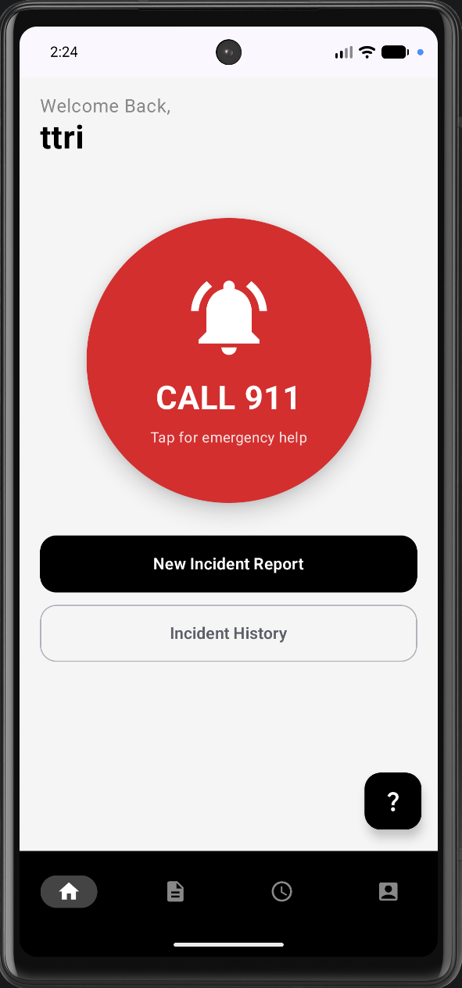
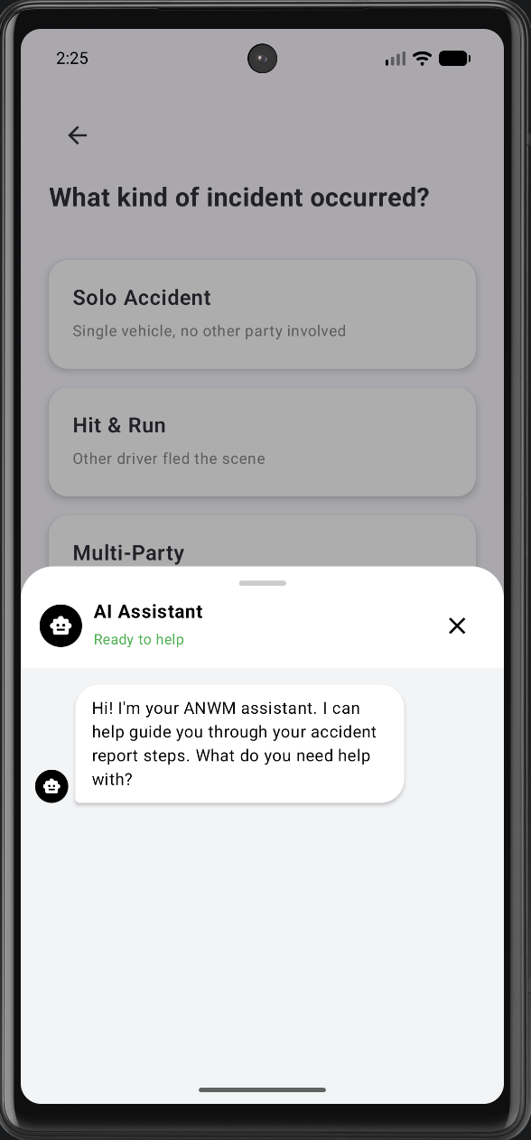
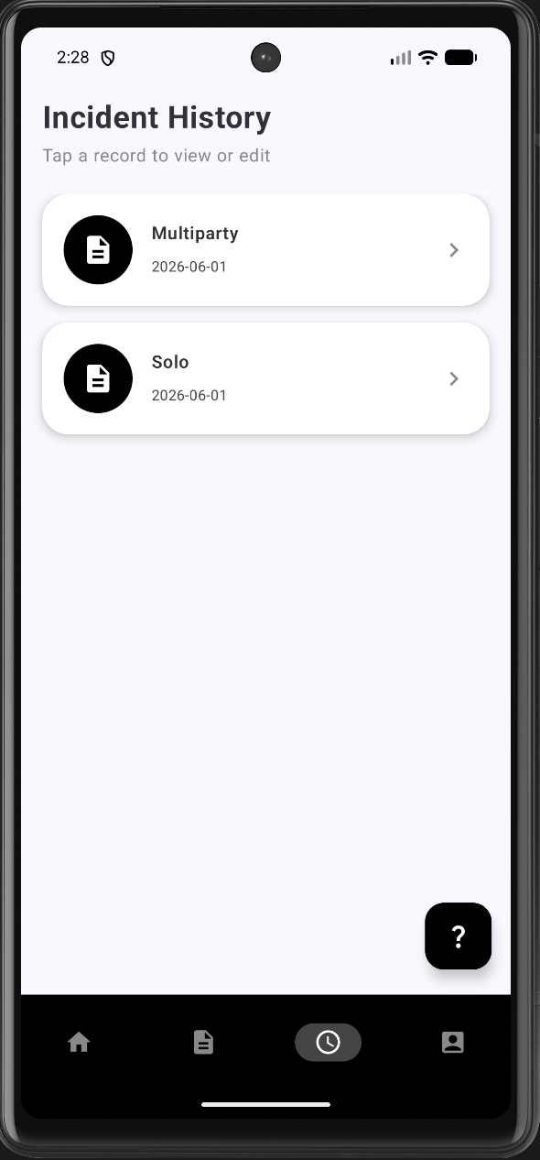
User interface preview
5
Figure 2. Login Page
Figure 3. Home Page
Figure 4. AI Page
Figure 5. History Page

Slide 6
Encryption
6
Every incident record is cryptographically hashed using SHA-256 before being written to the database
SHA-256 same cryptographic primitive that secures blockchain
When record is saved, all incident fields are compiled into a single string and processed through a SHA-256 hash function
Hash is stored alongside the record in Firestore
If anyone modifies even one character of the record after saving it, re-hashing produces a completely different result which would show tampering

Slide 7
Database & Storage Architecture
7
Used a Firebase Cloud Firestore – a NoSQL document database, instead of a traditional relational database
Incidents don't have complex relationships with other tables – each report is tied to one user, which is what Firestore is designed for
Data is structured in levels – each user has their own space in the database and their incident records live in that space: users {uid} incidents {incidentId}
Photos are compressed and stored as a Base64 encoded strings directly into the incident document – no separate storage service

Slide 8
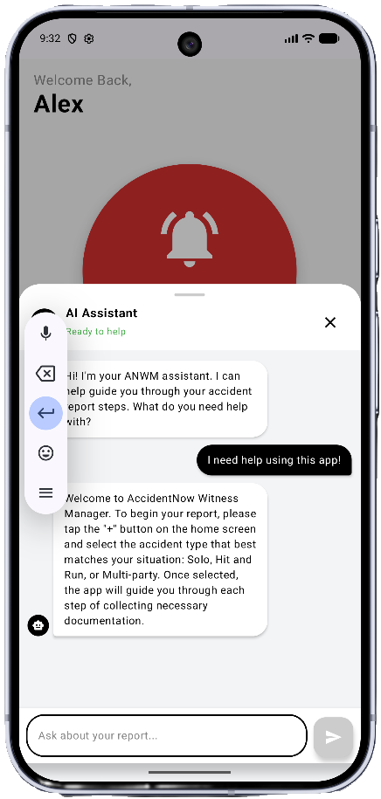
Artificial Intelligence
8
Why AI Assisted?
Convert chaotic, unstructured verbal or written witness accounts into structured database fields.
Gemini 3.1 Flash-Lite
Selected for its ultra-low latency on mobile networks, low API overhead, and exceptional parsing speed.
AI Functionality
Handles automated semantic categorization, key entity extraction, and dynamic contextual aid.
AI Limitations
Strictly mitigated using predetermined JSON schemas and programmatic validation guardrails to eliminate hallucinations, keep AI focused, and limit unrelated responses.
Figure 6. Chatting with AI

Slide 9
Project Future Improvement
9
More intuitive user interfaces
Export to PDF file or email option
Application preference modifications
Customer support
App privacy and permission modifications
Deploy to the Playstore

Slide 10
Challenges
10
Firebase Storage requiring a paid plan
Learning new technologies such as Kotlin, Android Studio, etc.
Emulator limitations – offline functionality
Time management
Distance team member
Different Gradle Version

Slide 11
What we learned/What we would do differently
11
Headstart on UI creation
Creating a separate channel for important resources
Better time management
Better resource allocation of team members

Slide 12
APP DEMO
12
(●’◡'●)
Notes:
Login into test account
Showcase Account section
Showcase Incident History
Use AI chat throughout next steps
Call 911
Create a new incident report with photos
Showcase incident report in history again

Slide 13

13

